Slide 1
Revolutionizing Pathology: The Power of Automation
Project Supervisor : Dr. Shashank Bhardwaj
Group Members : Amit Kr. Dubey
Aman Sinha
Mukul Deep

Slide 2
Introduction Benefits of Automation in Pathology Applications of Automation in Pathology Challenges of Automation in Pathology Future of Automation in Pathology Conclusion

Slide 3

Introduction
Pathology is a critical aspect of healthcare that involves the study and diagnosis of diseases through the examination of tissues and bodily fluids. The traditional method of pathology involves manual examination of samples under a microscope, which can be time-consuming and prone to human error.
However, with the advent of automation technology, pathology has undergone a significant transformation. Automation of pathology involves the use of advanced technologies such as artificial intelligence, machine learning, and robotics to improve the accuracy, speed, and efficiency of pathology processes.

Slide 4

Benefits of Automation in Pathology
Automation of pathology offers several benefits over traditional methods. For instance, it reduces the risk of human error, improves accuracy, and enhances the overall quality of diagnoses. It also increases the speed of pathology processes, enabling healthcare providers to make faster and more informed decisions.
Moreover, automation of pathology allows for better standardization of processes, making it easier to compare results across different laboratories and institutions. This is particularly important in research settings where consistency and reproducibility are crucial.

Slide 5

Applications of Automation in Pathology
Automation of pathology has numerous applications across various fields. For example, in cancer diagnosis, automation technology can help identify cancerous cells with greater accuracy and speed, improving patient outcomes. In addition, automation can aid in drug discovery by enabling researchers to analyze large datasets quickly and efficiently.
Automation technology can also be used in forensic pathology to analyze crime scene evidence and provide accurate and reliable information for legal proceedings. Furthermore, automation can assist in veterinary pathology, enabling veterinarians to diagnose diseases in animals with greater accuracy and speed.

Slide 6

Challenges of Automation in Pathology
Despite the many benefits of automation in pathology, there are also some challenges associated with its implementation. One major challenge is the high cost of acquiring and maintaining automation technology. Additionally, there is a shortage of skilled professionals who can operate and maintain these complex systems.
Furthermore, there are concerns about the potential loss of jobs due to automation. While automation can increase efficiency and reduce costs, it may also lead to job displacement and unemployment in certain sectors of the healthcare industry.

Slide 7

Future of Automation in Pathology
The future of automation in pathology looks promising, with continued advancements in technology and increasing demand for faster and more accurate diagnoses. Artificial intelligence and machine learning will play an increasingly important role in pathology, enabling pathologists to analyze large datasets and identify patterns that may not be visible to the human eye.
Moreover, automation technology will continue to evolve, becoming more affordable and accessible to smaller laboratories and healthcare providers. As a result, we can expect to see widespread adoption of automation technology in pathology in the coming years.

Slide 8
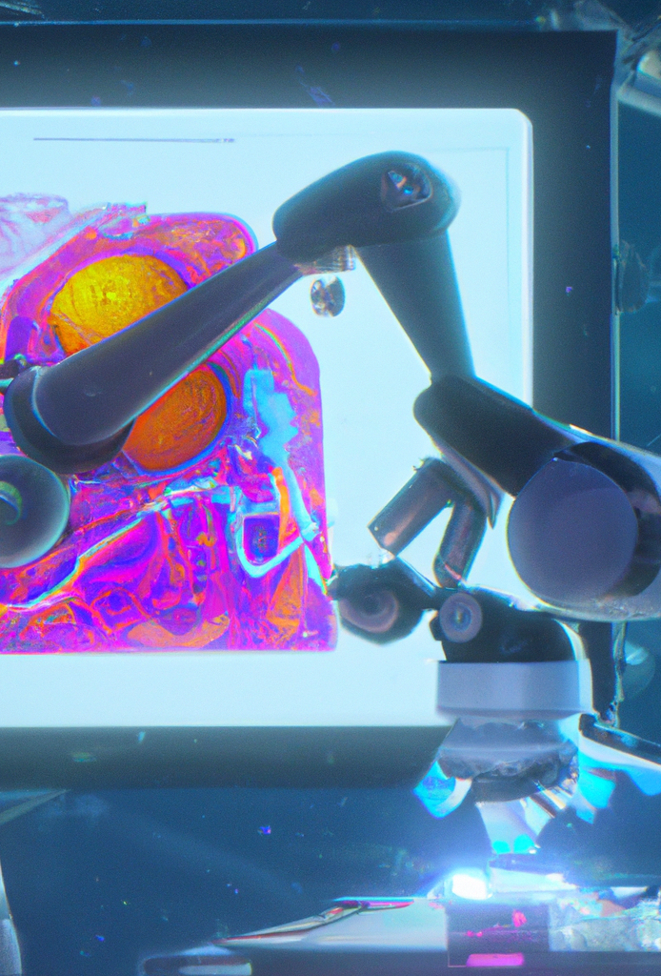
Conclusion
In conclusion, automation of pathology represents a significant advancement in healthcare technology. It offers numerous benefits over traditional methods, including increased accuracy, speed, and efficiency. However, there are also challenges associated with its implementation, such as high costs and potential job displacement.
Despite these challenges, the future of automation in pathology looks bright, with continued advancements in technology and increasing demand for faster and more accurate diagnoses. As we move forward, it is essential to strike a balance between the benefits of automation and the potential risks to ensure that we can achieve the best possible outcomes for patients and healthcare providers alike.

Slide 9


